Slide 1
Systems Engineering Based
“Draft” MRL 1-4 Criteria Development
Dr. Al Sanders
President & Owner, Principal Consultant
Design-Vantage Technologies, LLC
January 23, 2018

Slide 2
Common MRL 1-3 Criticisms
TRL/MRL 4 is where “Real” Systems Engineering Starts and is the Furthest “Left” that Manufacturing should Move....
During TRL 1-2 Efforts there is no Design or Manufacturing Application that the Technology can be Linked to....
Many of the MRL Threads are Not Applicable for Early S&T and therefore MRL1-3 Criteria do not Add Value....
Current Splattering of MRL 1-3 Criteria are too Aggressive and Further Development is not Value Added....
Not Enough Specificity in the MRL 1-3 Criteria and the Terms need to be better Defined before the Criteria are Useful....
Much of the Information the MRL 1-3 Criteria are Asking for Conflicts with the Scope of TRL 1-3 Activities....

Slide 3
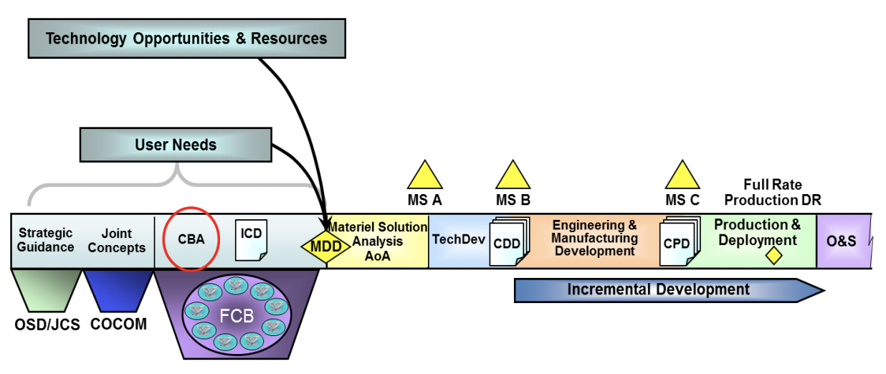
Early Development Planning Focus
Early S&T: TRL/MRL 1-3
Gap Closure Solutions
Technology
Development
Technology Insertion
Early SE: TRL/MRL 1-3
Capability Needs/Gaps
System Development
Concept
Refinement
CONOPS
Source: “Capabilities-Based Assessment (CBA) Handbook: A Practical Guide to the Capabilities-Based Assessment”, Office of Aerospace Studies, Air Force Materiel Command (AFMC), March 2014. https://www.dau.mil/cop/rqmt/DAU%20Sponsored%20Documents/Handbook%20USAF%20CBA%2010%20Mar%202014.pdf
Pre-MDD Focus is on Knowledge Development but there is a Clear Bifurcation between Early S&T and Early SE

Slide 4
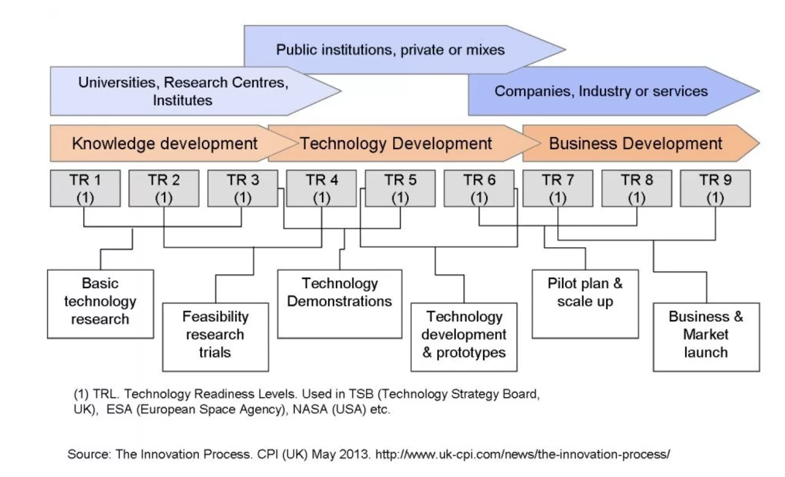
TRL Regime Development Focus
TRL 1-3 Regime Focus is also on Knowledge Development and the MRL 1-3 Criteria should also Align with this Objective

Slide 5
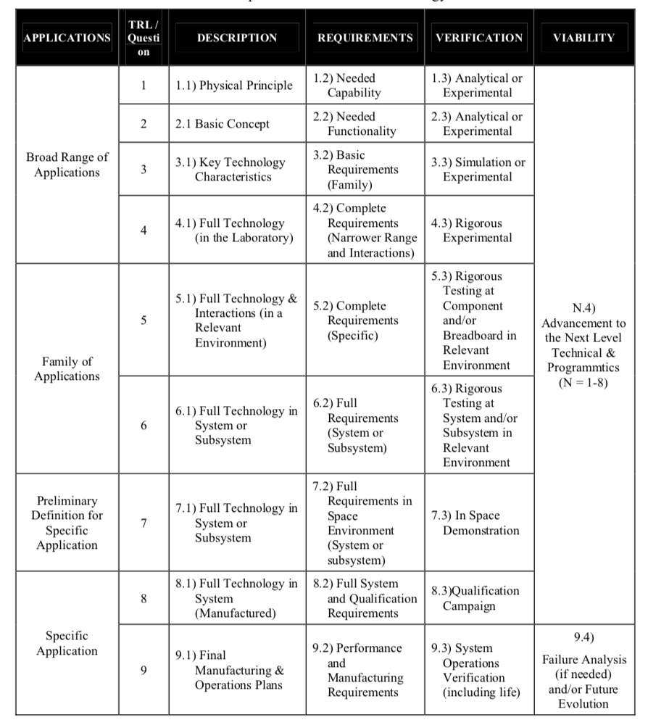
European Space Agency TRL Approach
Source: European Space Agency, “Technology Readiness Levels Handbook for Space Applications”, September 2008. https://artes.esa.int/sites/default/files/TRL_Handbook.pdf
ESA TRL’s Based on NASA TRL’s but Addition of Applications & Rqmts to Criteria Indicative of an “SE-Based” Approach

Slide 6
TRL 1-9 Application Focus Alignment
Marketing 101
Product Hierarchy
TRL 8-9: Product Variant
TRL 7: Product Type
“Application Refinement”
TRL 6: Product Line
TRL 5: Product Class
TRL 4: Product Family
TRL 3: Part Family
“Need Family”
TRL 2: Device Family
TRL 1: M&P Family/Class
Source: https://www.nasa.gov/sites/default/files/trl_static_image_1300x900.jpg
Applications of Technology are Actually Known in TRL 1-3 Activities but Require a “Need Family” Perspective

Slide 7
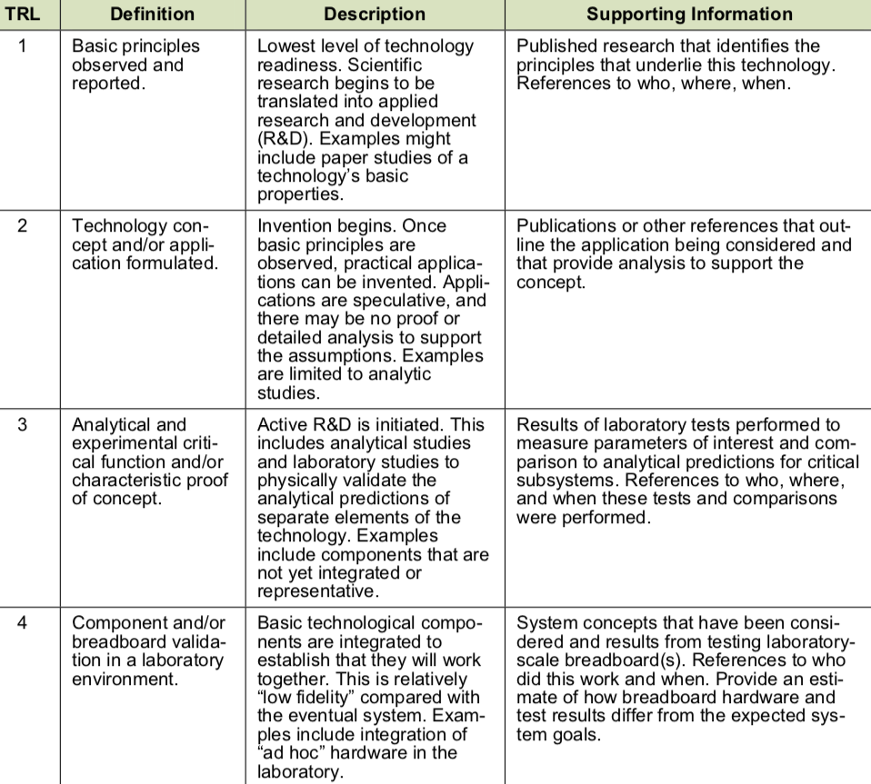
Early S&T Maturation Vehicle Alignment
Should the MRL 1-3 Criteria for Threads that Support an Improved Understanding and Prediction of Physical Producibility and Manufacturing Phenomena be Based on Similar Types of Maturation Studies?
Descriptive Studies
Analytic Studies
Attempts to Develop MRL 1-3 Criteria to Date have Struggled to Break this Barrier...
Analytical Models
MRL 4 Maturation Focus is being able to Produce the Technology (i.e., the Breadboard) in a Laboratory Environment
Breadboards
Source: DOD Technology Readiness Assessment (TRA) Deskbook, Appendix C, July 2009. http://www.dtic.mil/docs/citations/ADA524200
Rather than Extrapolating MRL Criteria Further to the Left in the S&T Process what if we Align with Early S&T Objectives?

Slide 8
TRL/MRL 1-3 Regime Analysis Methods
TRL/MRL 1: Descriptive studies* that generate hypotheses to describe cause and effect patterns of variables such as who, where, and when in relation to the what (i.e., outcome)
TRL/MRL 2: Analytic studies* that test hypotheses about critical cause-effect relationships and answer the why and how to achieve the what and focus on collecting data/information to correlate cause-effect variables
TRL/MRL 3: Analytical models that enable the prediction of physical behavior (i.e., effects) due to changes in critical input variables (i.e., causes) for components not yet integrated
*Source: Department of Health and Human Services, Centers for Disease Control and Prevention, “Facilitators Guide: Descriptive and Analytic Studies”, 2013. https://www.cdc.gov/globalhealth/healthprotection/fetp/training_modules/19/desc-and-analytic-studies_fg_final_09252013.pdf
Something to Consider.... How can you Trade Producibility and Manufacturability at MRL 4 if you cannot Predict it?

Slide 9
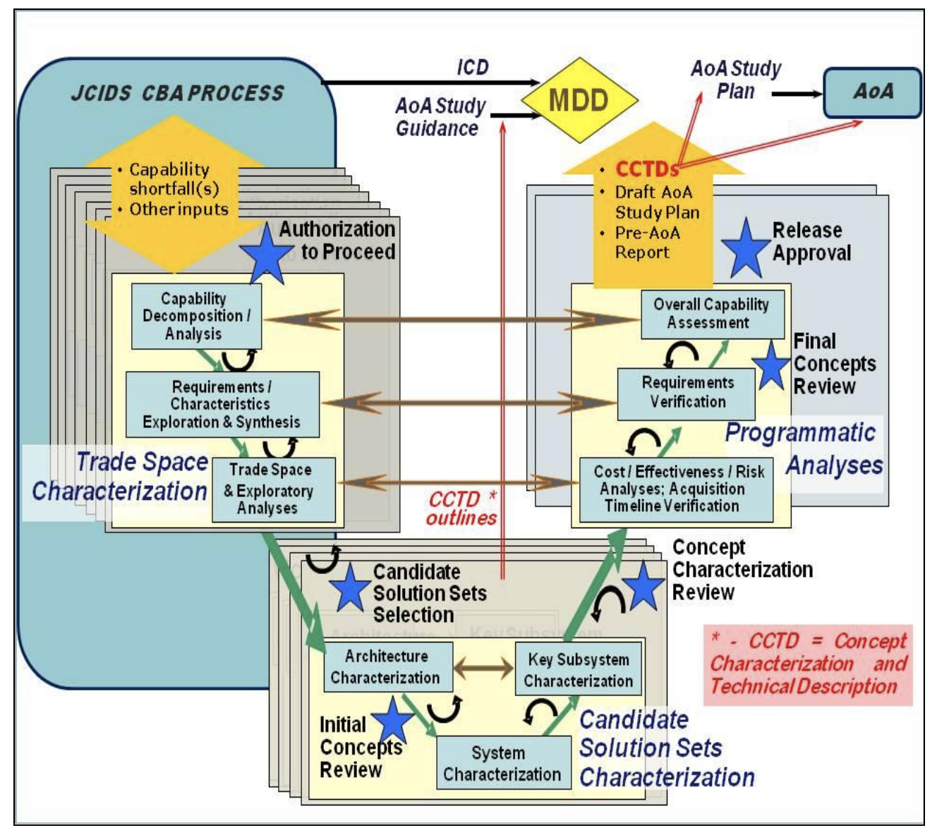
Pre-MDD Early Systems Engineering
Do Early SE Activities Focused on Knowledge Development of User Needs to Understand Current System Capability Gaps Align with the same Types of Early S&T Knowledge Development Activities to Understand Physical Phenomena Aimed at Improving System Performance?
Source: United States Air Force, Assistant Secretary of the Air Force for Acquisition (SAF/AQ), “Early Systems Engineering Guidebook”, Version 1, March 2009. https://www.dau.mil/cop/pm/_layouts/15/WopiFrame.aspx?sourcedoc=/cop/pm/DAU%20Sponsored%20Documents/USAF%20Guidebook%20Early%20Systems%20Engineering%20Guide%2031%20Mar%202009.pdf
Current System Capability Shortcomings, Future Operational Needs, & Candidate Solution Sets Known Prior to MDD

Slide 10
Early SE Development Planning Alignment
Early SE Development Planning
Descriptive Studies
Operational Needs & CONOPS
Trade Space Characterization
Analytic Studies
Continuum
Capability Based Assessments
Candidate Solution Set Characterization
Analytical Models
Initial Capability Documents
MDD
Programmatic Analyses
Breadboards
Analysis of Alternatives
Source: DOD Technology Readiness Assessment (TRA) Deskbook, Appendix C, July 2009. http://www.dtic.mil/docs/citations/ADA524200
Rather than Extrapolating MRL Criteria Further to the Left in the SE Process what if we Align with Early SE Objectives?

Slide 11
MRL Thread & Sub-Thread Focus
Thread & Sub-Thread ”Naming” Conventions Start to Loose Relevance in Early S&T and Early SE Activities

Slide 12
Early SE/S&T/MFG Functional Alignment
Planning/
Executing
Early Mfg
Engagement
Assessing/
Evaluating
Customer
Needs
Analyzing/
Understanding
Physical
Phenomena
Early S&T
Early SE
SE
SE/S&T
Alignment
Sub-Thread Functional Activity Analysis used to Develop MRL 1-3 Criteria Independent of “Naming” Conventions

Slide 13
MRL Sub-Thread Functional Decomposition
(Planning/Executing Activities)
MRL 1-3 Knowledge Supports
Sub-Threads Drive Alignment of Early SE and S&T Activities

Slide 14
MRL Sub-Thread Functional Decomposition
(Assessing/Evaluating Activities)
MRL 1-3 Knowledge Supports
Sub-Threads Primarily Aligned with Early SE Activities

Slide 15
MRL Sub-Thread Functional Decomposition
(Analyzing/Understanding Activities)
MRL 1-3 Knowledge Supports
Sub-Threads Primarily Aligned with Early S&T Activities

Slide 16
Discuss “Draft” MRL 1-4 Matrix Criteria

Slide 17
Conclusions & Recommendations
New Way to Approach MRL 1-3 Criteria Development Presented to MRL WG for Consideration that Integrates Manufacturing into Early S&T and Early SE Activities using their Language
Suggest Developing a Few Early S&T Examples (Case Studies) of How the New MRL 1-4 Criteria can be Applied to Support S&T Technology Development Activities before Changing Criteria
Suggest Developing a Few Early SE Examples (Case Studies) of How the New MRL 1-4 Criteria can be Applied to Support SE Early Development Planning Activities before Changing Criteria
Suggest Revisiting MRL 4-7 Criteria and Evaluating from a Perspective of How they can be Improved to better Support Pre-Competitive Manufacturing USA MII Applied R&D Activities
Thank You For Your Time and Constructive Feedback!

Slide 18
Questions?
Contact Information:
Dr. Al Sanders
Design-Vantage Technologies, LLC
al.sanders@design-vantage.com

Slide 19
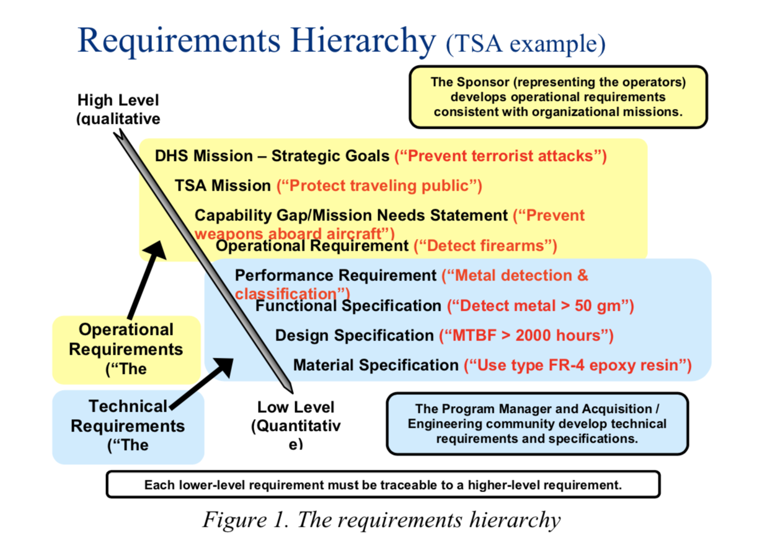
Operational vs. Technical Requirements
Source: U.S. Department of Homeland Security, “Developing Operational Requirements: A Guide to Cost-Effective and Efficient Communication of Needs”, Version 2.0, November 2008. https://www.dhs.gov/xlibrary/assets/Developing_Operational_Requirements_Guides.pdf

